Slide 1
Review II
Session 26
Henry Lucky, S.Kom. M.Kom.

Slide 2
Outline Materials
Session 04
Dynamic programming
Graph
NP-Completeness
Approximation algorithms

Slide 3
Learning outcomes
26
LO 1: Explain fundamental concept of analysis algorithms
LO 2: Apply algorithm techniques and methods
LO 3: Solve a problem using specific algorithm.
LO 4: Compare several algorithm design methods

Slide 4
Review II
In this session, the lecturer should solve the problems together with students or guide the students to solve each problems presented from each materials.

Slide 5
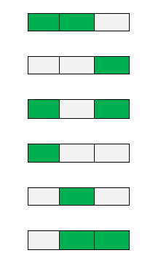
Dynamic Programming
Painting the fence
Given a fence with n posts and k colors, make an algorithm to find out the number of ways of painting the fence so that not more than two consecutive posts have the same colors.
For example:
Input: n = 3, k = 2
Output: 6
Explanation: We have the following possible combinations:
Where white is the first color and green is the second color.
*note that there is no white white white nor green green green, because no more than two consecutive posts have the same color

Slide 6
Dynamic Programming
Longest palindrome subsequence
A palindrome is a nonempty string over some alphabet that reads the same forward and backward. Examples of palindromes are: civic, racecar, and aibohphobia (fear of palindromes).
Give an efficient algorithm to find the longest palindrome that is a subsequence of a given input string. For example, given the input character, your algorithm should return carac. What is the running time of your algorithm?

Slide 7
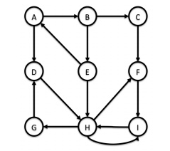
Graphs
Strongly Connected Components
Given the graph below, give the strongly connected components using Tarjan’s algorithm!

Slide 8
NP-COmpleteness
Bonnie and Clyde
Bonnie and Clyde have just robbed a bank. They have a bag of money and want to divide it up. For each of the following scenarios, either give a polynomial-time algorithm, or prove that the problem is NP-complete. The input in each case is a list of the n items in the bag, along with the value of each.
The bag contains n coins, but only 22 different denominations: some coins are worth x dollars, and some are worth y dollars. Bonnie and Clyde wish to divide the money exactly evenly.
The bag contains n coins, with an arbitrary number of different denominations, but each denomination is a nonnegative integer power of 2, i.e., the possible denominations are 1 dollar, 2 dollars, 4 dollars, etc. Bonnie and Clyde wish to divide the money exactly evenly.
The bag contains n checks, which are, in an amazing coincidence, made out to "Bonnie or Clyde." They wish to divide the checks so that they each get the exact same amount of money.

Slide 9
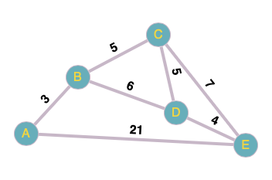
Approximation Algorithms
TRAVELING SALESPERSON PROBLEM
Imagine you are a salesperson traveling to multiple cities to meet clients, and you want to find the shortest possible route to visit each city exactly once and return to your starting point.
Find an approximate solution to the Traveling Salesperson Problem (TSP) starting from City A.

Slide 10
References
Thomas H. Cormen. (2022). Introduction to algorithms: Fourth edition. The MIT Press. Chapter 14, 20, 34, 35.

Slide 11
Thank you
Review II
September, 2023

